Slide 1
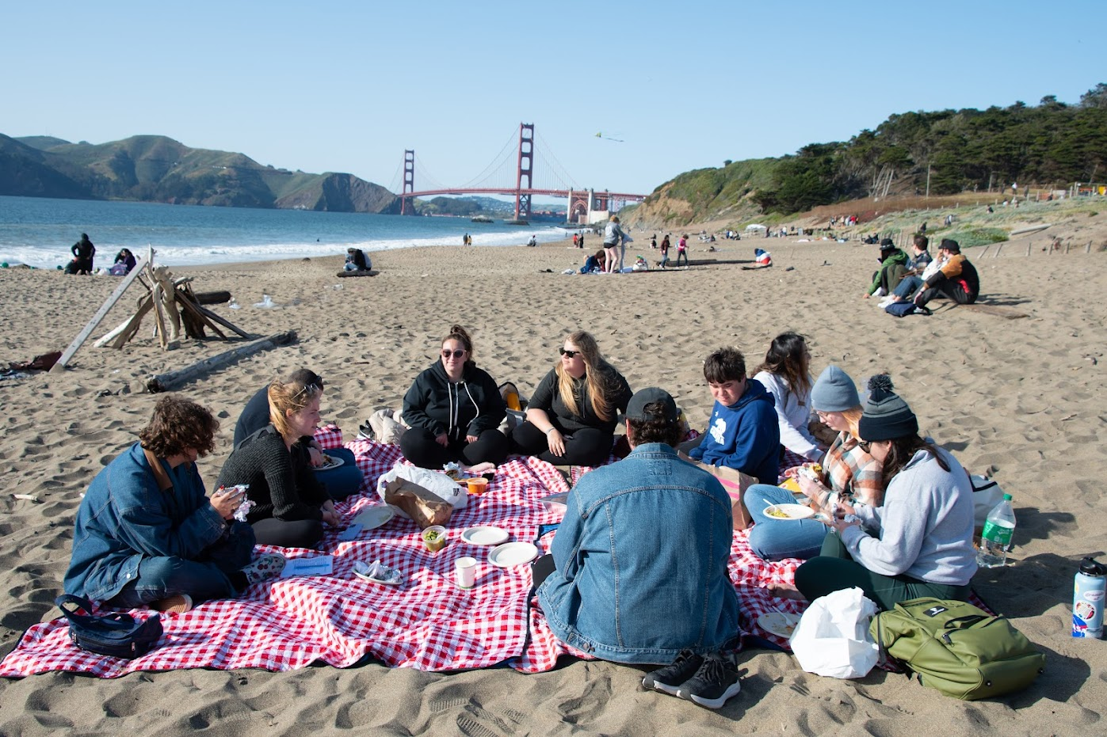

ANNUAL REPORT
2022-2023

Slide 2
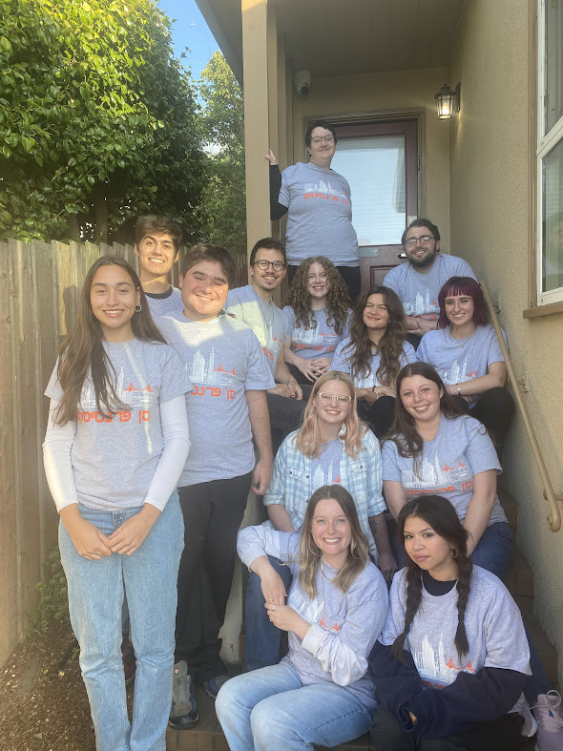
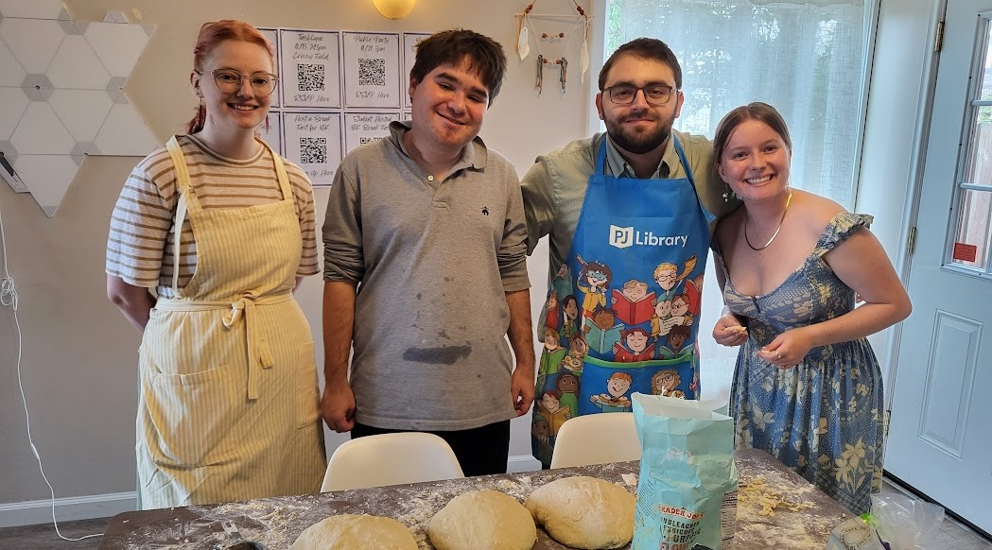
Mission Statement
We’re here to support all Jewish college students in San Francisco and fortify the future of the Jewish people.
We learn about each student’s relationship with Judaism and then help them explore their Jewish identity, build Jewish community, and develop them into our future Jewish leaders.

Slide 3
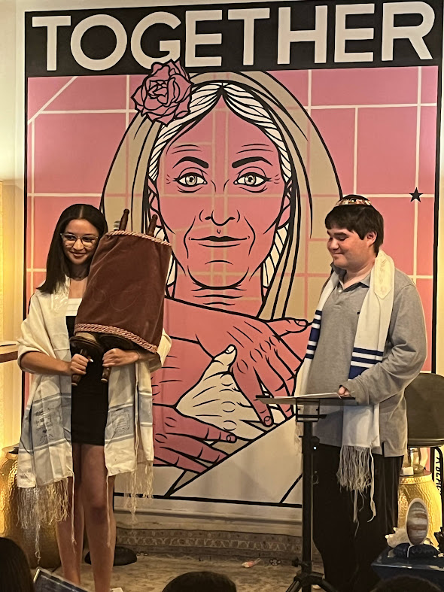
SF Hillel Values
We believe in the inherent worth, value, humanity, and dignity of each person.
As Jewish tradition teaches, each of us is created b'tzelem Elohim, in the Divine image.
To that end, we are committed to pluralistic Jewish life on campus, a diverse workforce, and the values of inclusivity.
We embrace all the identities, experiences, and backgrounds each person brings.
We respectfully welcome students, professionals, and community members of all abilities, races, ethnicities, socio-economic backgrounds, gender identities, sexual orientations, observances, and interfaith backgrounds, so that we can work together to contribute to, and experience the full richness of, Jewish life and community.

Slide 4
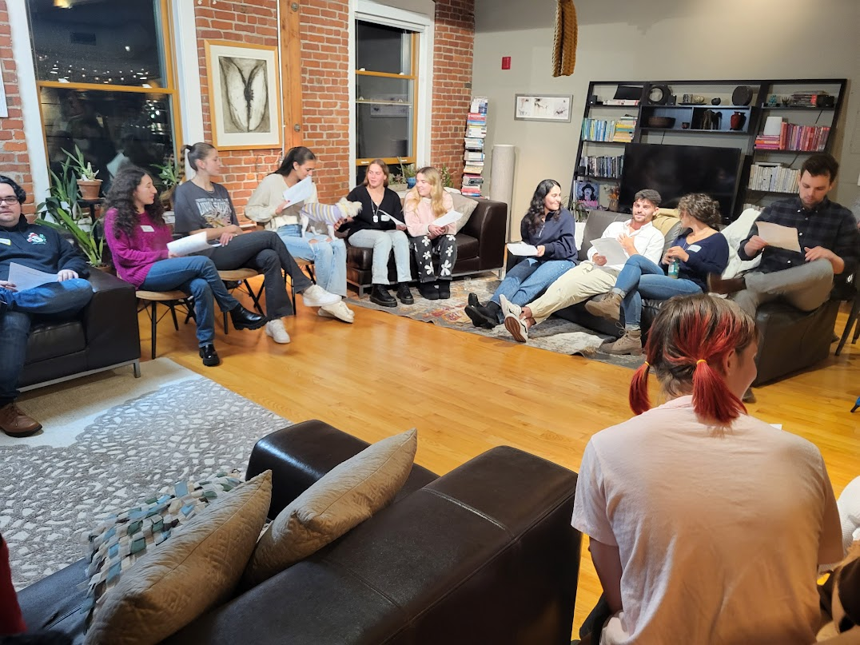
Vision
Statement
San Francisco Hillel will create thoughtful and meaningful connections for Jewish students with each other, the broader Bay Area Jewish Community, and with Israel so that each student can develop and strengthen their Jewish identity. In so doing, SF Hillel will be recognized as an integral part of the Bay Area Jewish Community, which will help make San Francisco an attractive destination for Jewish students.
We will be financially resilient, ensuring that we can meet the needs of our students for generations to come.

Slide 5
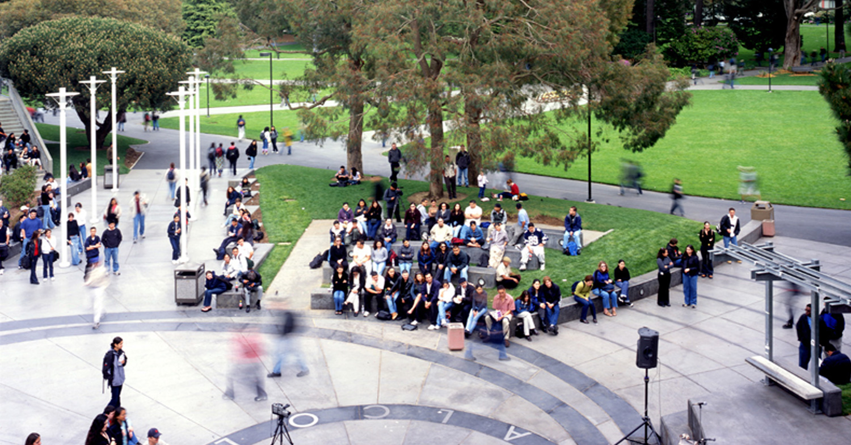










COLLEGES SERVED

Slide 6
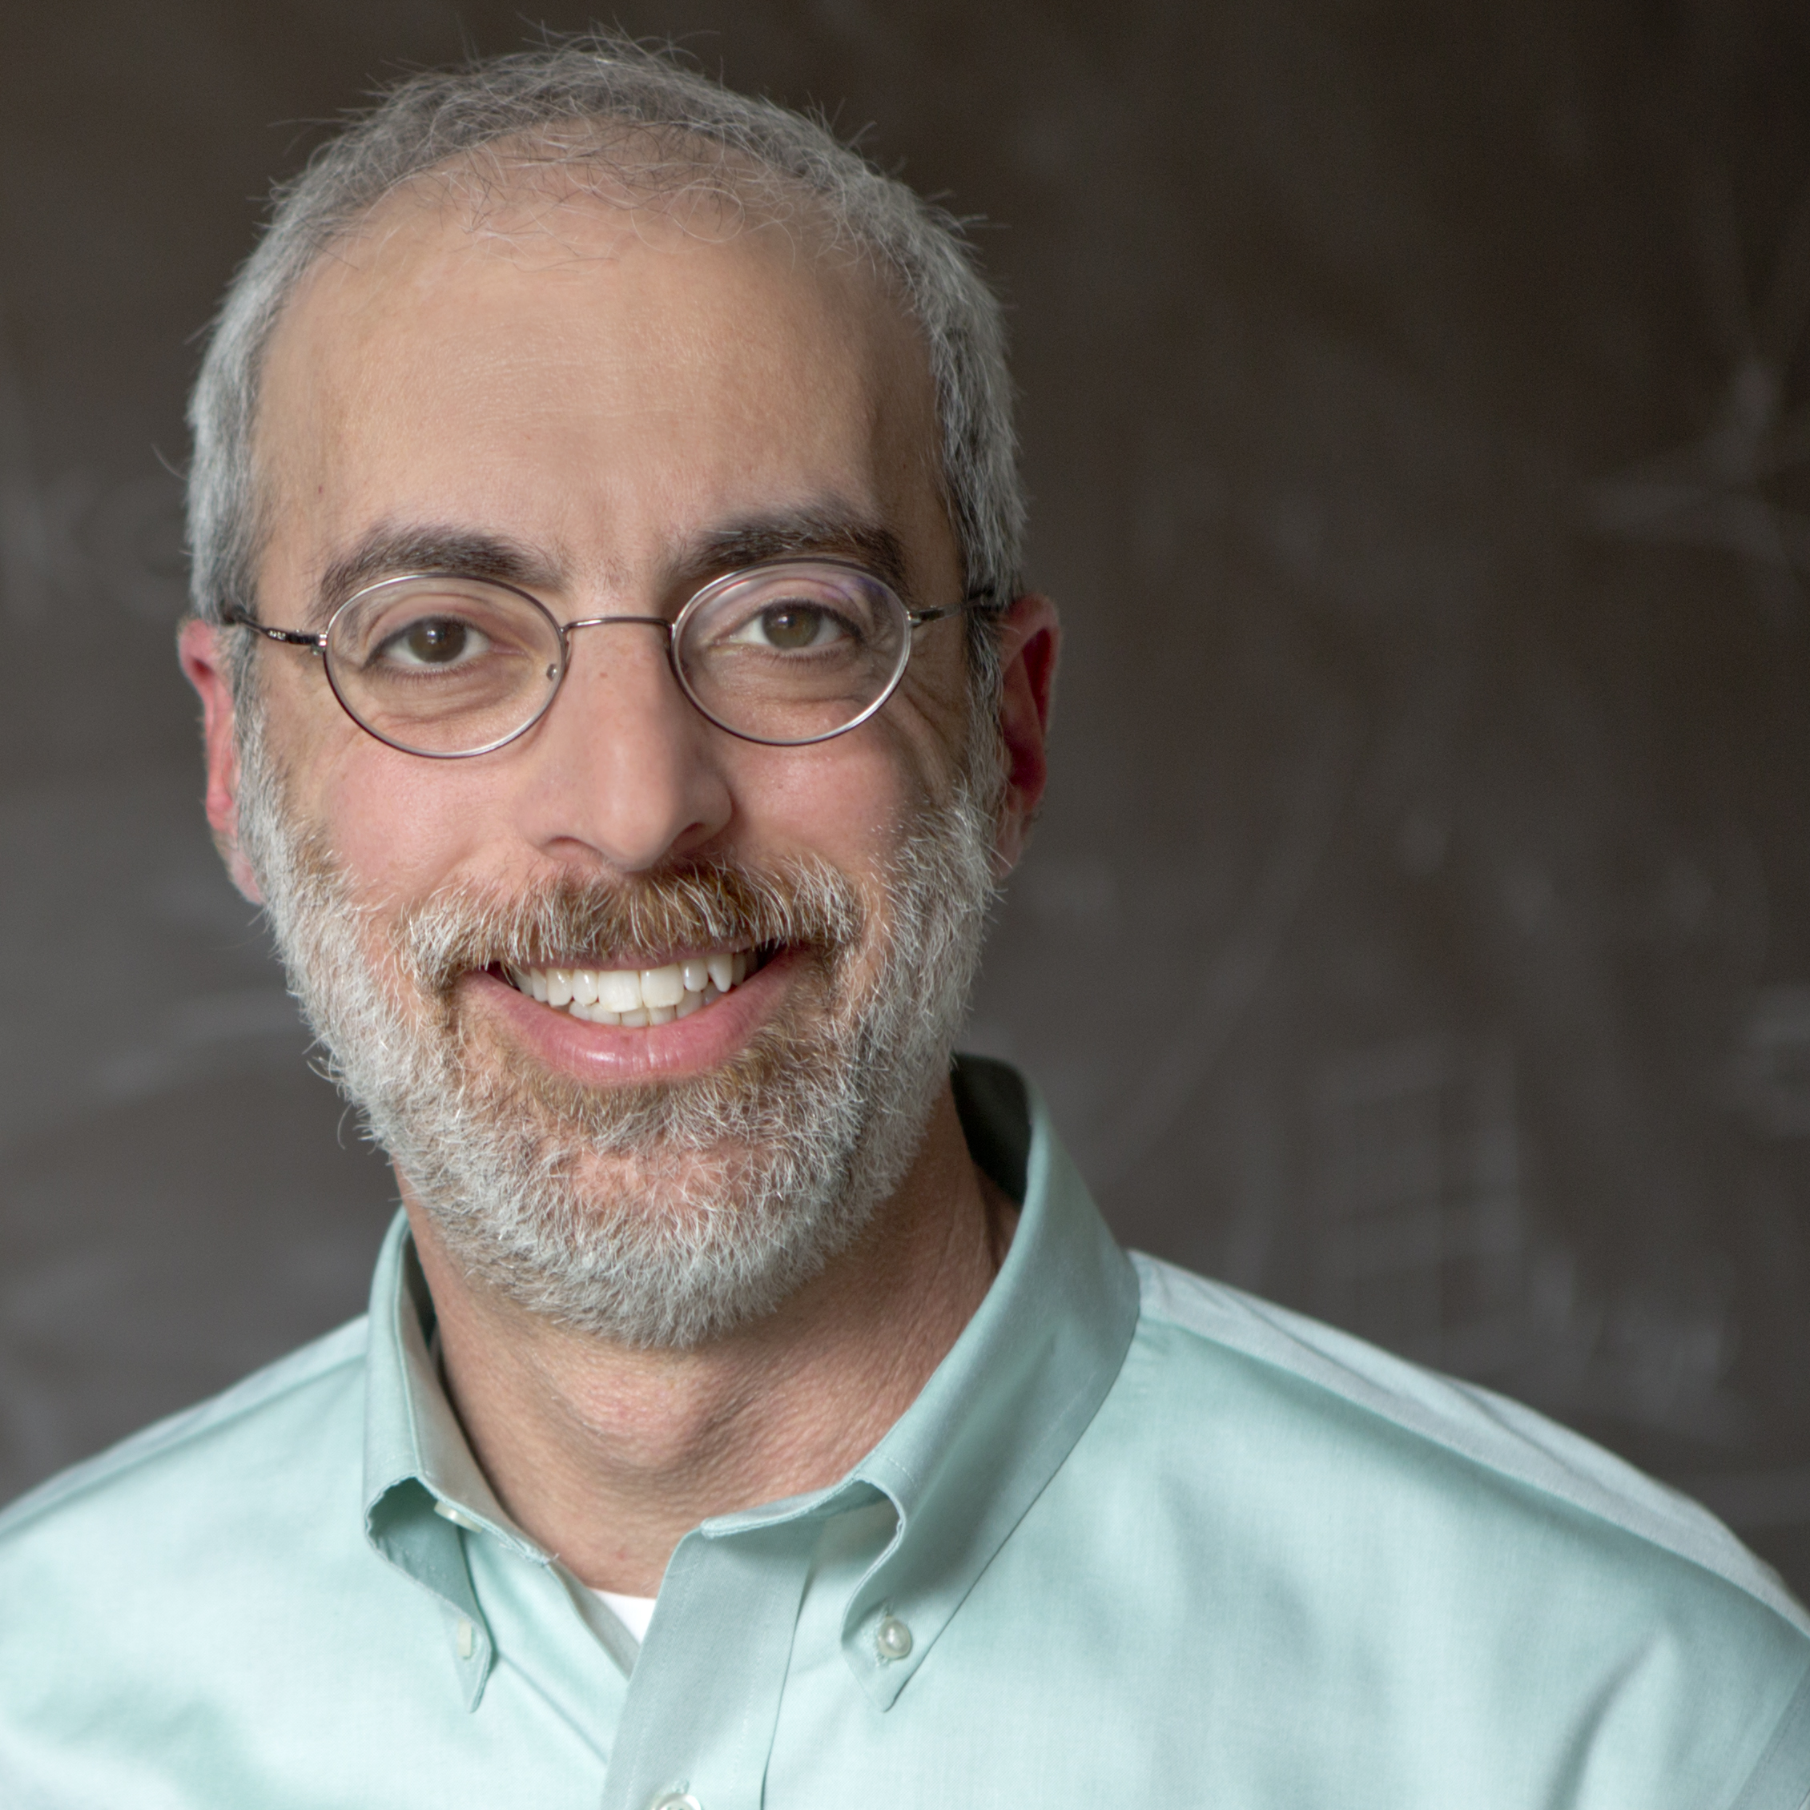
Dear SF Hillel Community,
This has been an exciting year for SF Hillel, and one of transition. We hired a new Executive Director, Roger Feigelson, and I began my first term as board president. We are so excited that Roger has joined us and has already made a tremendous contribution. We have seen a surge in student engagement, be it for shabbat dinner, Passover seder, the variety of programming we offer, private counseling, or just providing a space for students where they feel safe and welcome. For the first time, and with a generous gift from the Federation, we opened a grocery “shuk” to address basic food needs of our students. This has proven to be extremely popular.
And last Spring we kicked off our capital campaign. A new building is essential, especially in these difficult times. Students need a space where they can feel safe and secure. We need a space large enough to accommodate all students who wish to join us, particularly for shabbat and holidays. We need private space where students can feel comfortable sharing. We are far along in the design and planning and hope to break ground next summer.
By all these measures, SF Hillel is thriving and meeting the needs of our students, our core mission. I am extremely excited about our growing and engaged board of trustees. As you’ll see in this report, we’ve refined our mission and vision, updated our financial accounting and reporting, expanded our programming, and brought on new staff. SF Hillel is an integral part of the San Francisco Jewish Community and serves a vital role in supporting our students and creating future Jewish leaders.
Of course, all of this requires resources. We look to the local Jewish community to make generous gifts to both our annual campaign and capital campaign so we can continue to succeed in serving our students.
N. Jeremy Kasdin
President, Board of Directors
President’s Message

Slide 7
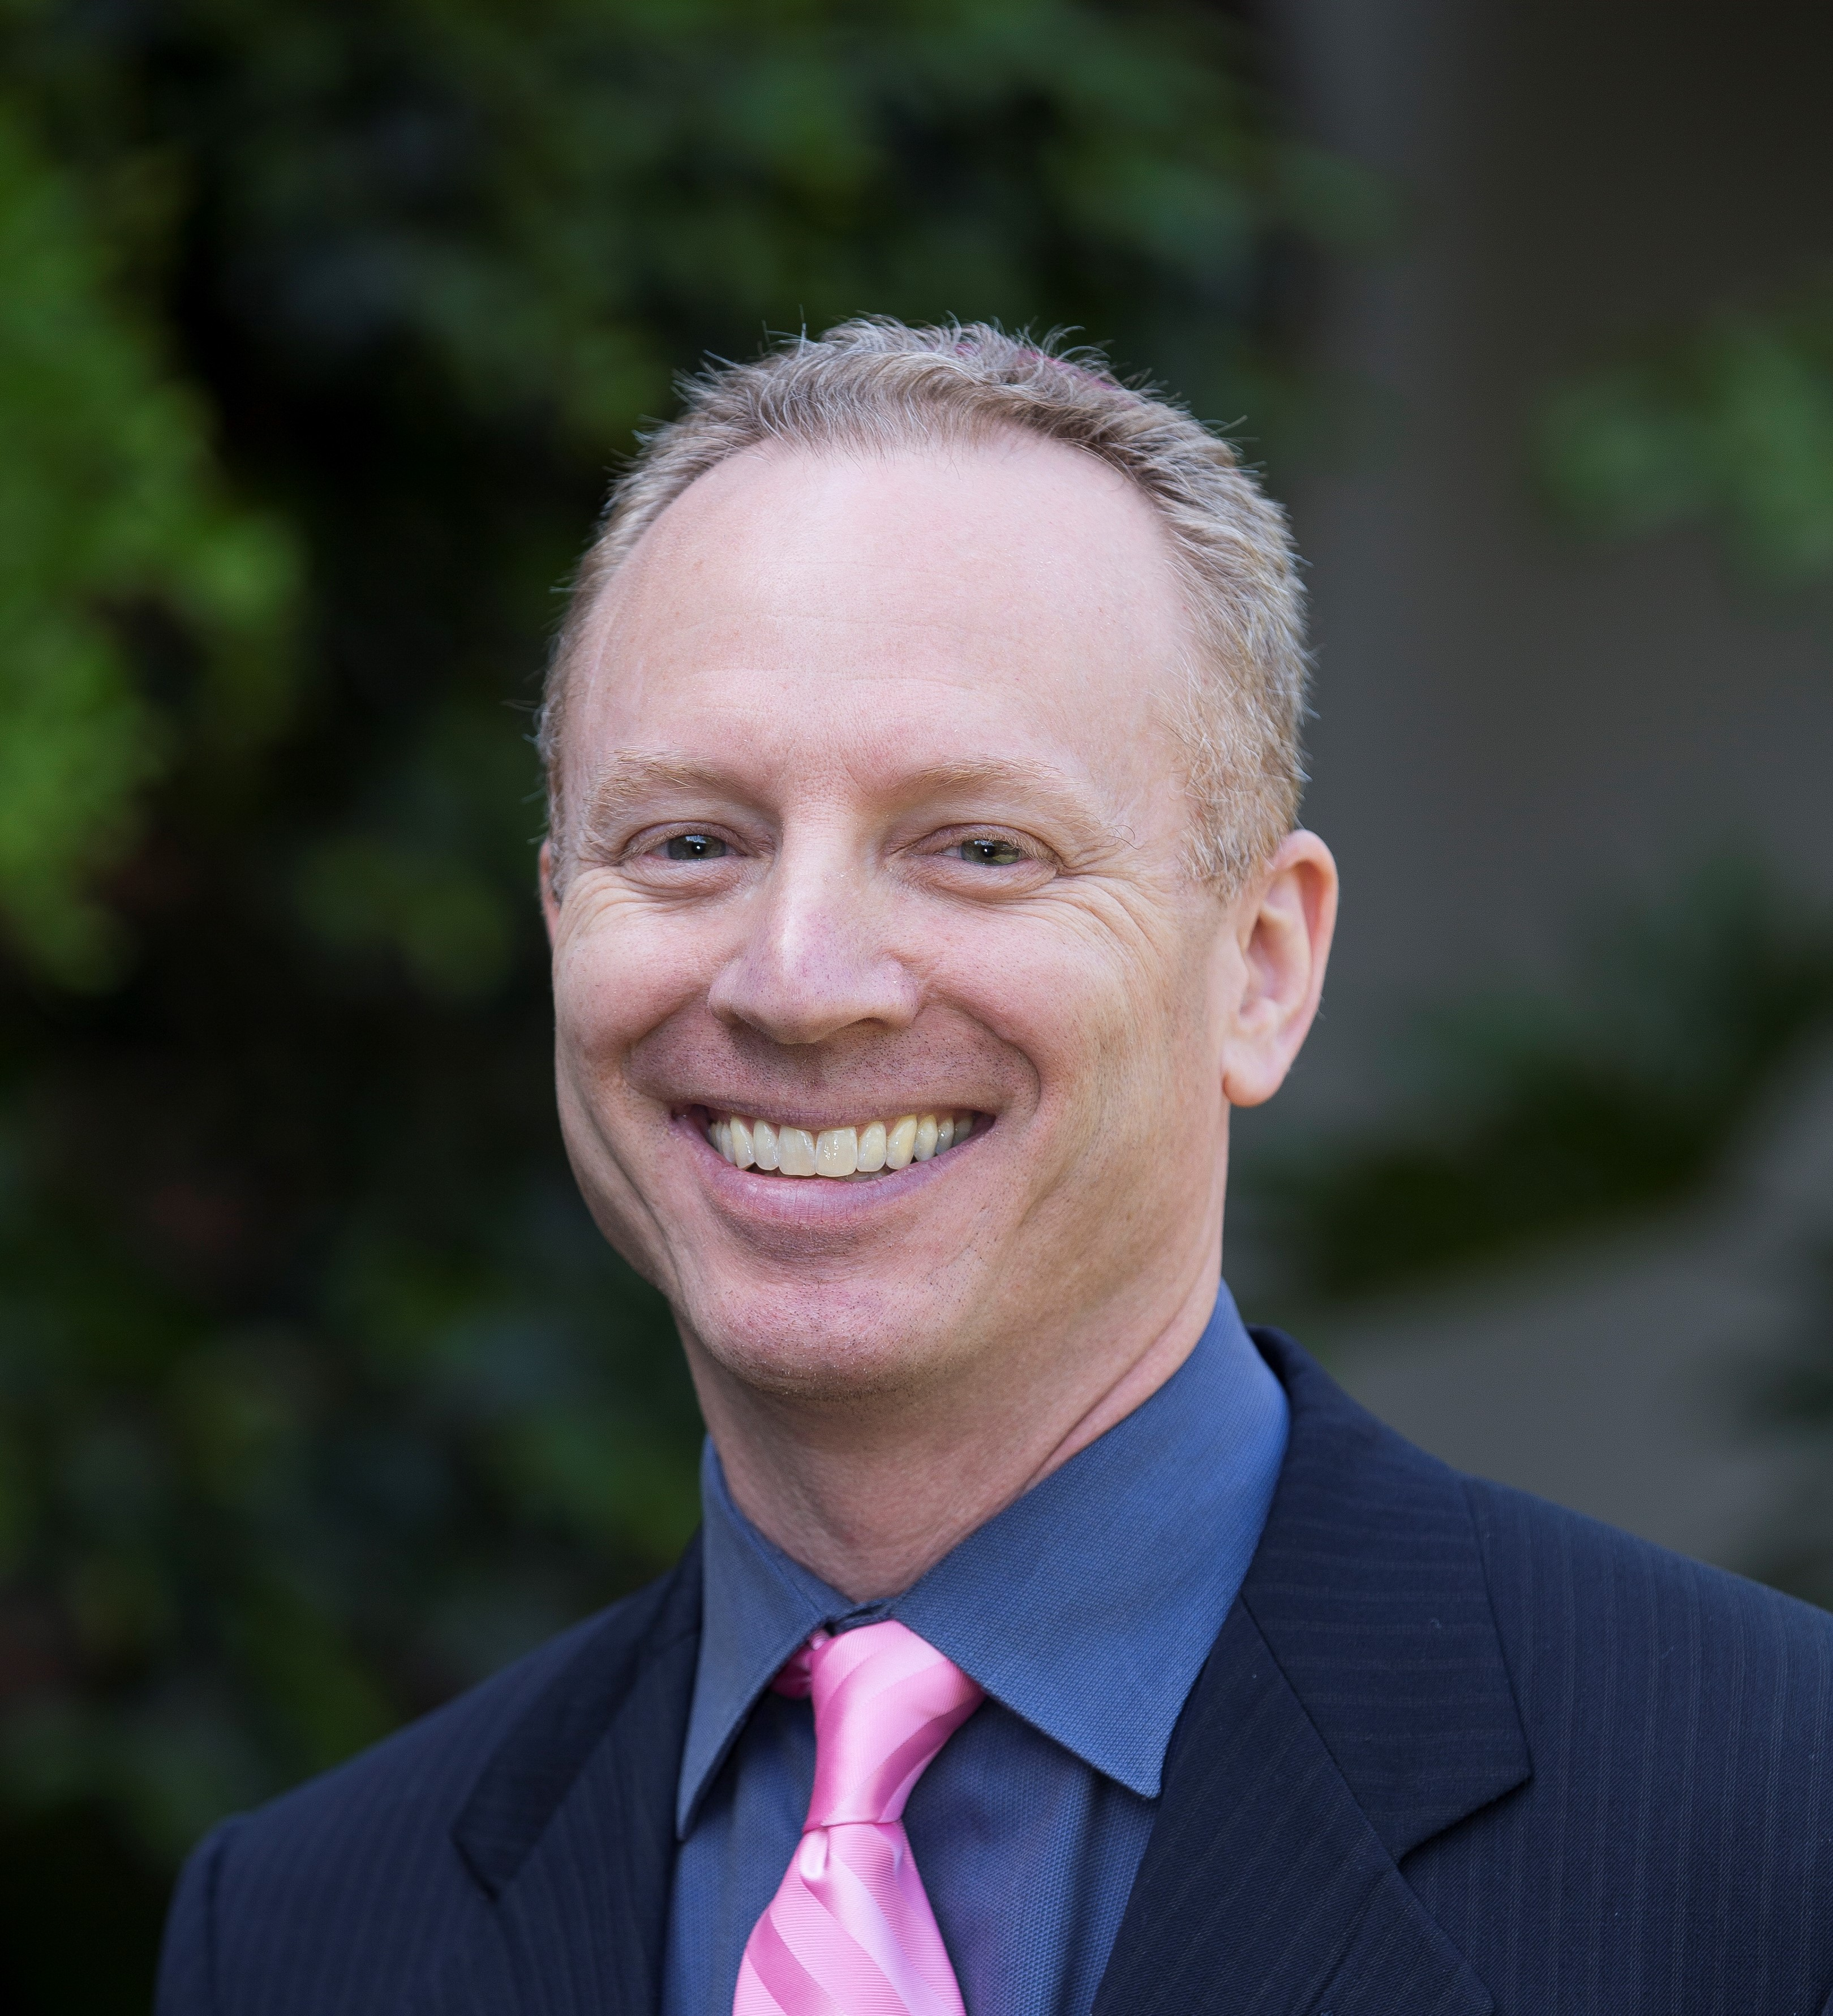
Executive Director’s Message
Dear SF Hillel Community,
Welcome to our new annual report! As I write this, I just passed my eight-month mark since the board of directors entrusted the important duty of running this critical organization to me. SF Hillel is the center for Jewish life for undergraduate and graduate students in San Francisco. With Jewish engagement on the decline, we’re on the front line of connecting students with their Jewish identify and each other. I like to say we’re fortifying the future of the Jewish people one college student at a time.
In this annual report you’ll find our mission statement, our core values, and our aspirations as to what we want to become. You’ll find the list of campuses we serve, our student engagement data from last year as well as our financials, not to mention a photo album highlighting many of our colorful and varied events over the course of the year. You’ll even find a high-level summary of our strategic objectives and our critical capital campaign.
Ultimately, it’s all about the students and supporting them in their journeys, regardless of where they come from or where they’re going. And everything we’re able to do is because of support from community members like you. Thank you for supporting us and thank you for taking the time to read this report.
Roger Feigelson
Executive Director

Slide 8





STUDENT LIFE
Received any connection or engagement from Hillel
GENERAL ENGAGEMENT
664
Engaged with Hillel from 1-5 times
BREADTH ENGAGEMENT
516
Engaged with Hillel 6 or more times
DEPTH ENGAGEMENT
148
DESIGN TRIBE LEADERS
22
Assumed student leadership roles

Slide 9
FINANCIAL REPORT
 | FY23 Budget ($Ks) | FY23 Actual ($Ks) | FY24 Budget ($Ks)
INCOME
Grants | $502 | $289 | $323
Direct Contributions | $285 | $308 | $395
Earned Revenue | $61 | $145 | $8
Total Income | $847 | $742 | $726
EXPENSE
Salaries & Related Expenses | $616 | $559 | $604
Professional Services | $59 | $110 | $62
General Admin | $81 | $71 | $85
Programs | $173 | $70 | $35
Total Expense | $930 | $810 | $787
Net Income | ($83) | ($68) | ($61)
Fiscal year 2023 was a long period of transition for San Francisco Hillel. The organization underwent an executive search to secure a new Executive Director and hired Roger Feigelson in February 2023. This transition, along with stock market fluctuations and an ongoing Capital Campaign, resulted in lower than budgeted expectations. In total we raised $742,000. Additional impacts:
  Some institutional funders decreased or withdrew funding due to a shift in their priorities.
  We applied for the Employee Retention Credit during COVID-19. While the FY23 “earned revenue” budget reflected a modest estimate, we received full funding, which greatly improved our position for FY23.
While revenue came in $105,000 under, expenses also came in under budget. The FY23 budget projected an $83,000 deficit, which we reduced to $68,000 with sophisticated financial tracking and expense monitoring.
  Due to the executive transition, SF Hillel saw decreased expenses for Salaries & Related costs and an increase in expenses for Professional Services related to SF Hillel's Interim Executive Director.
  Programmatically, SF Hillel thrived during FY23. We were unable to run the Maccabee Task Force trip to Israel/Palestine, however, which reduced expenses a further $103,000.
Sophie Case, Director of Finance and Operations
GENERAL ENGAGEMENT
ACTIVE ENGAGEMENT
MEANINGUL ENGAGEMENT
DEPTH ENGAGEMENT

Slide 10
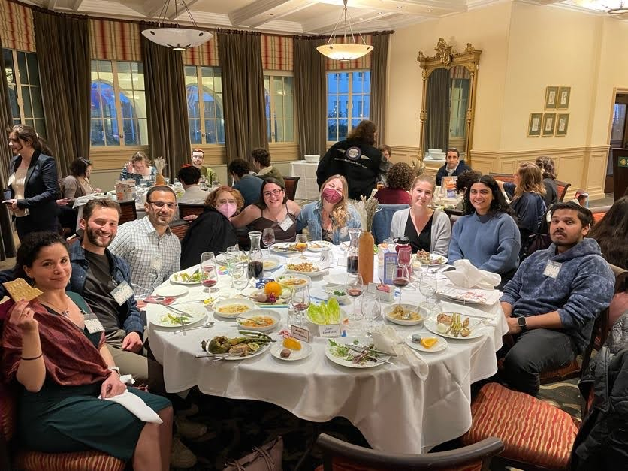
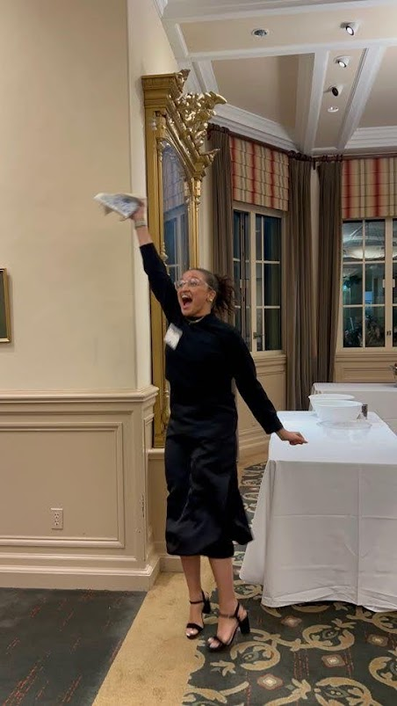
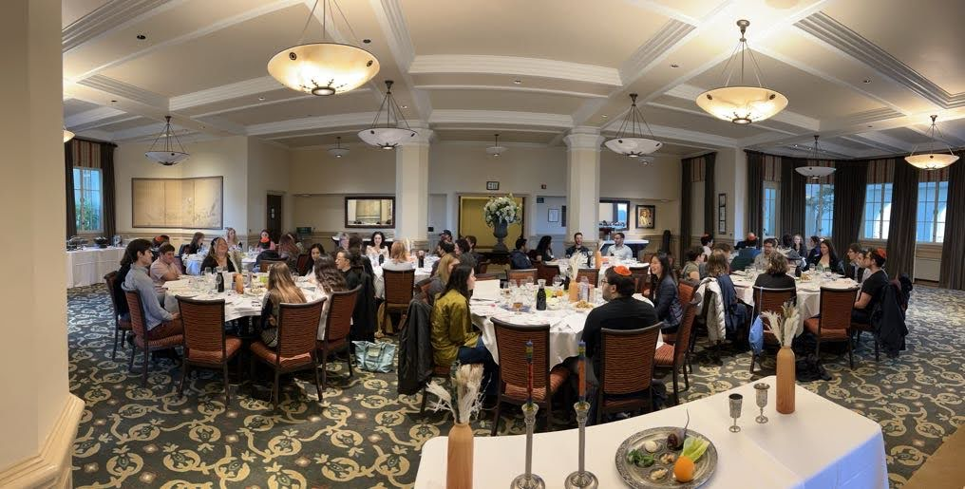
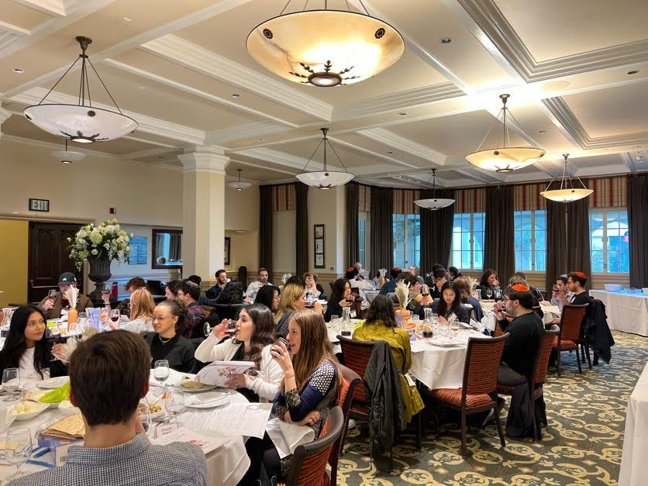
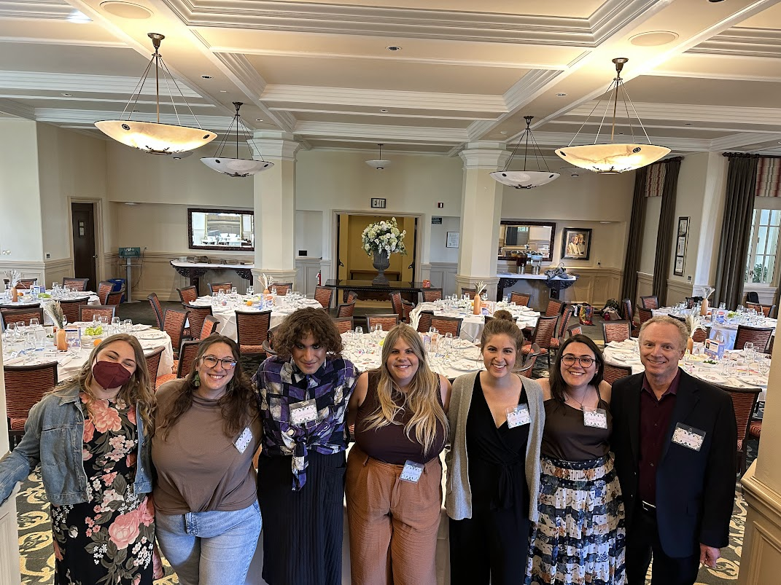
PASSOVER
SEDER
Lone Mountain Room
University of San Francisco

Slide 11
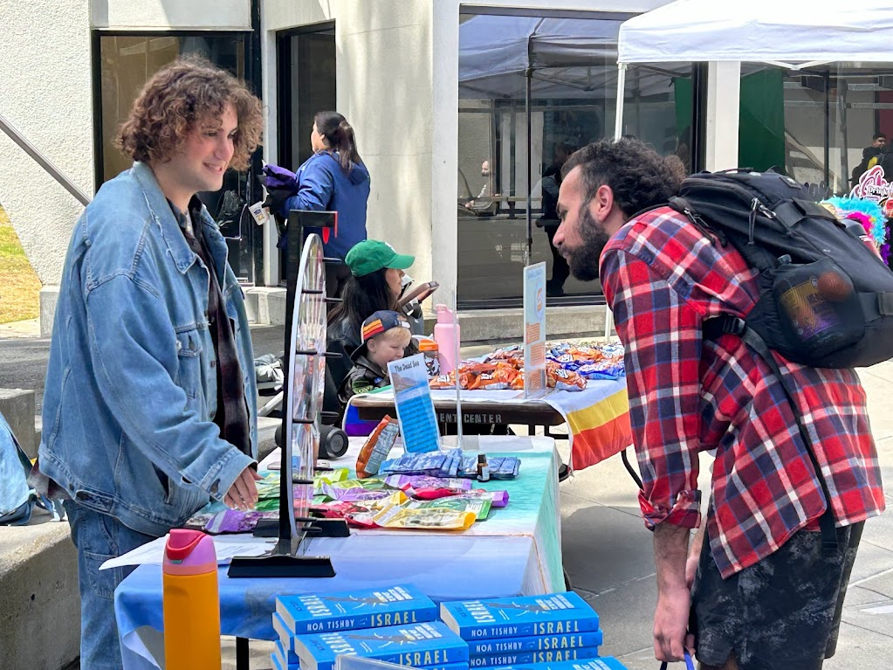
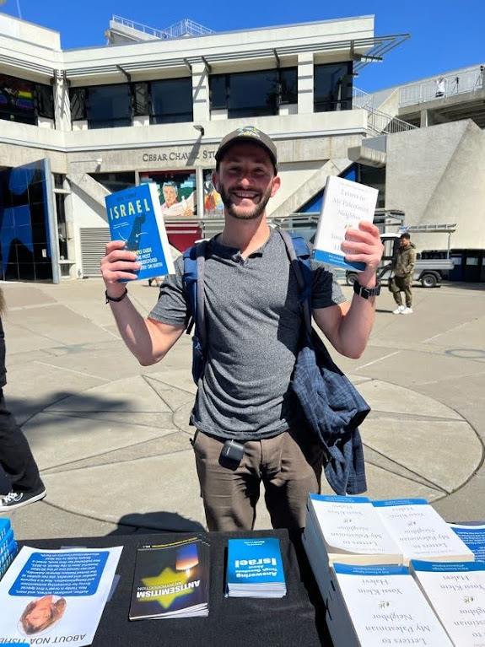
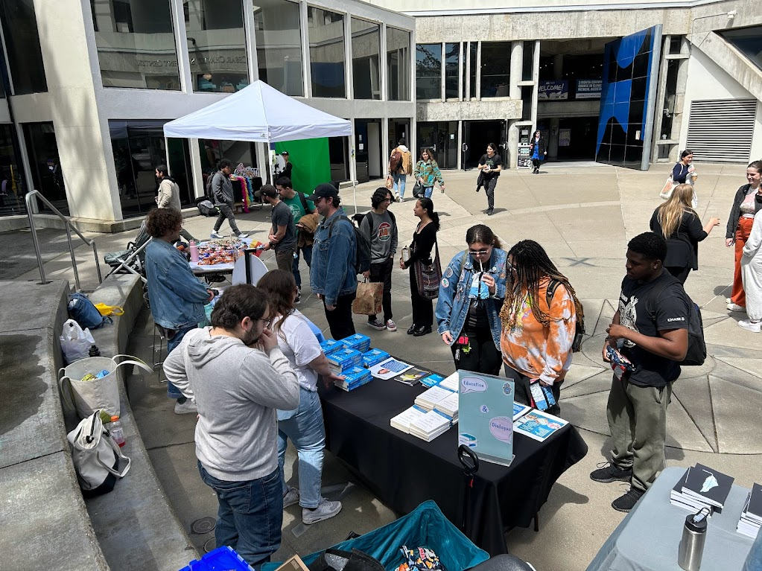
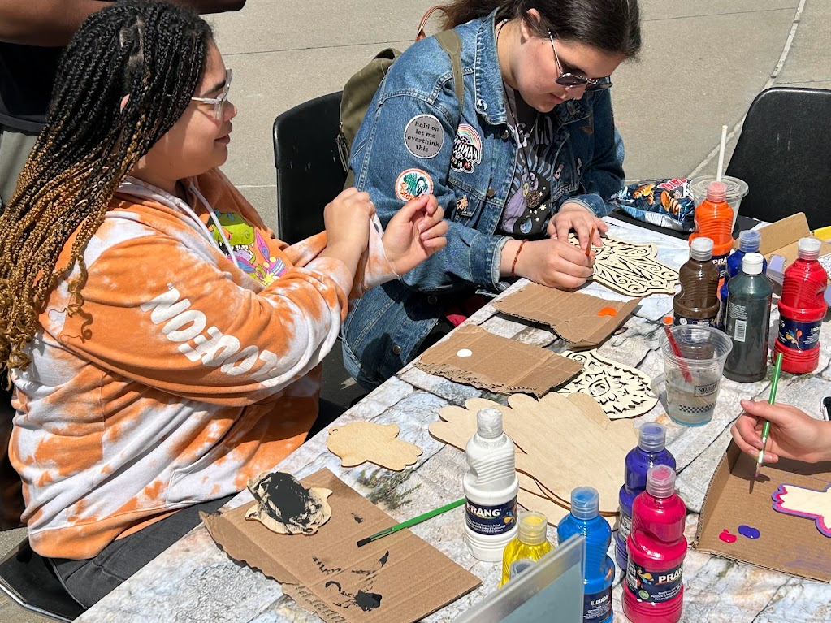
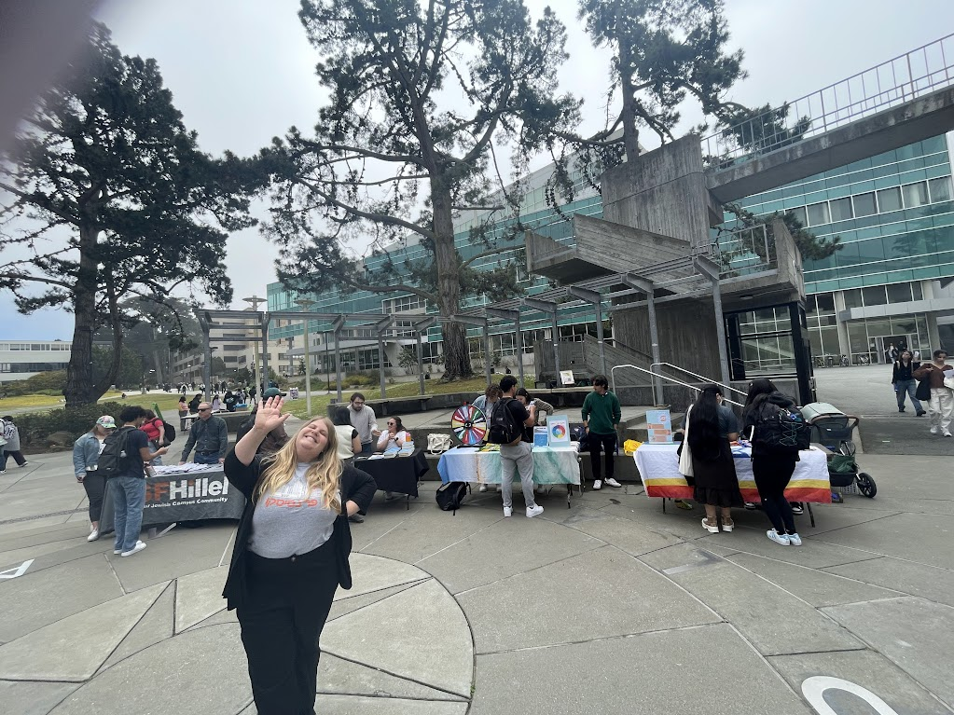
ISRAEL @ 75
Malcolm X Plaza
San Francisco State University

Slide 12
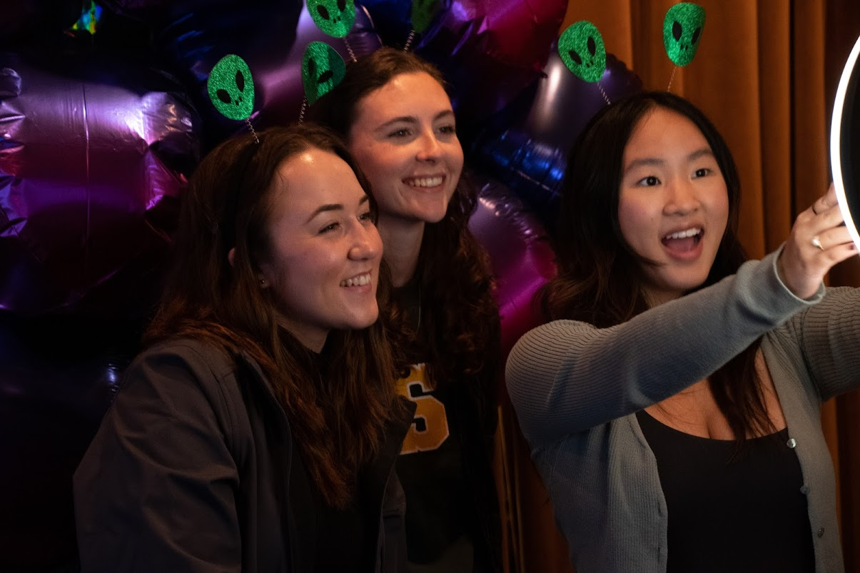
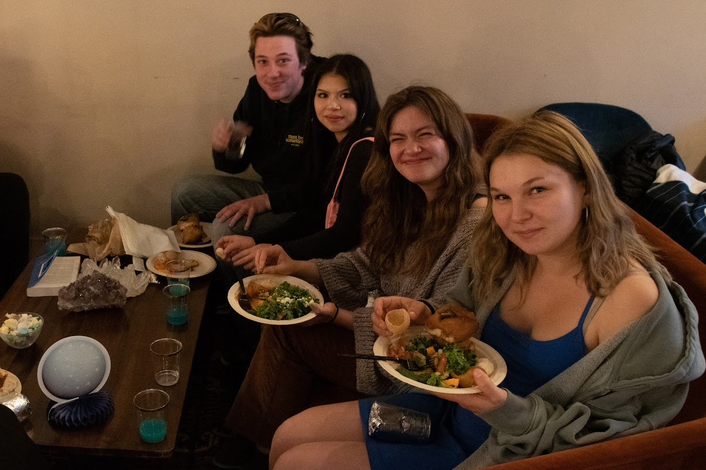
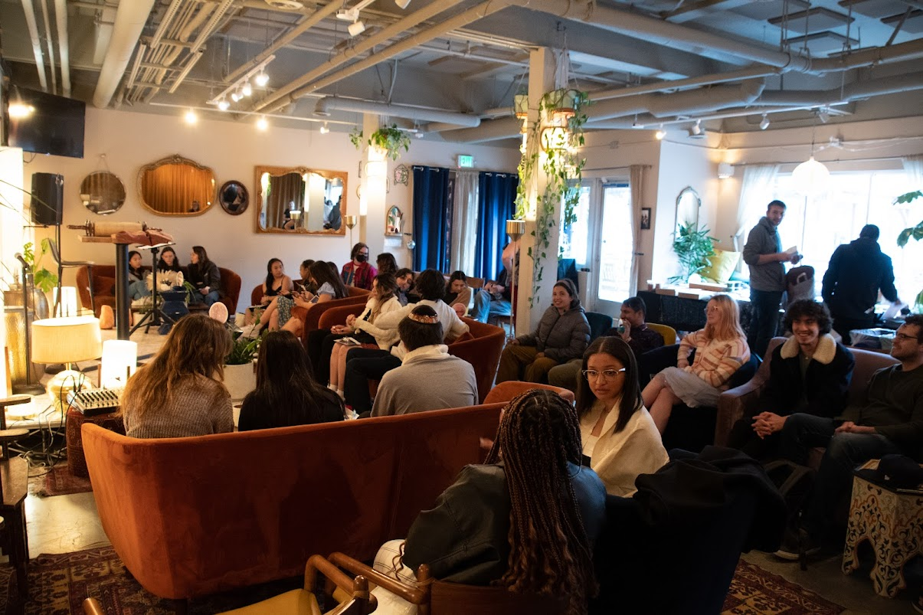
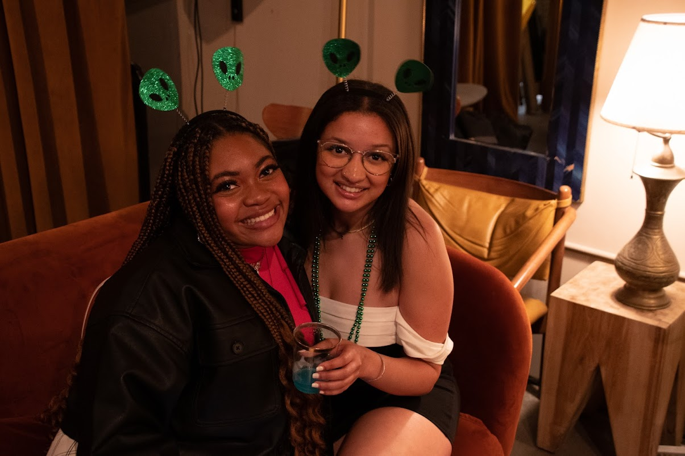
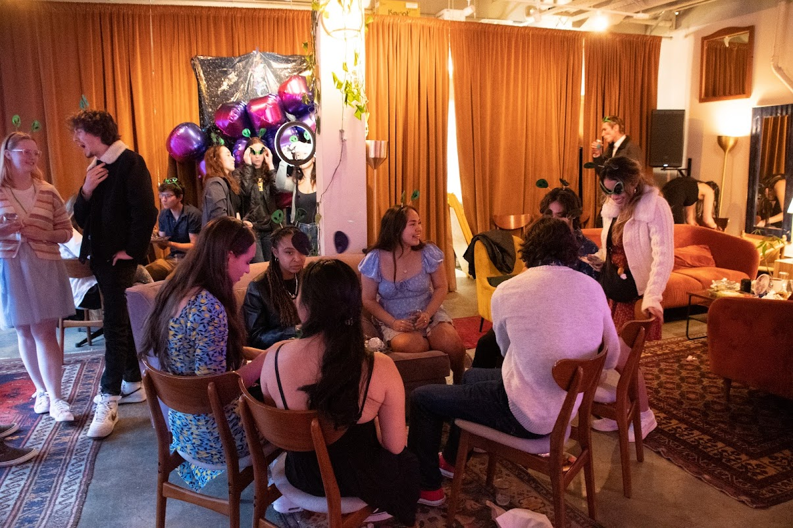
FINAL SHABBAT
Manny’s
San Francisco

Slide 13
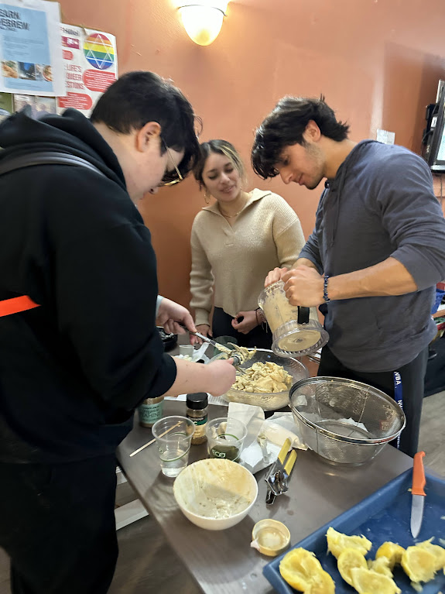
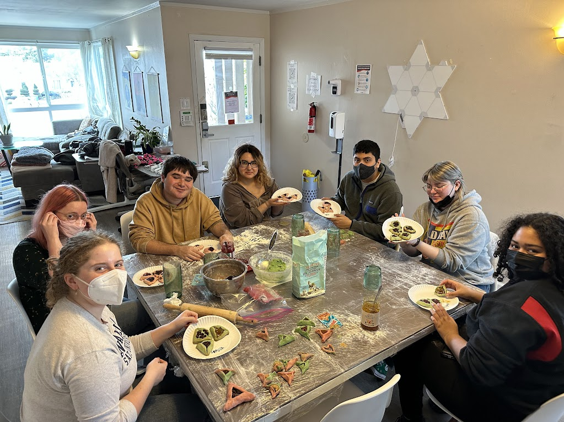
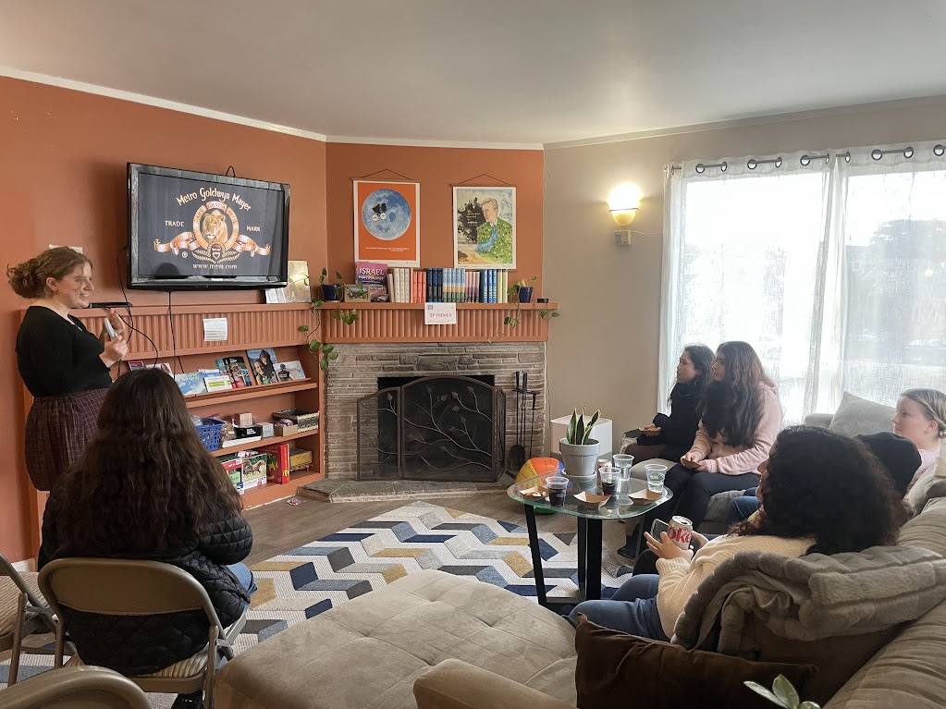
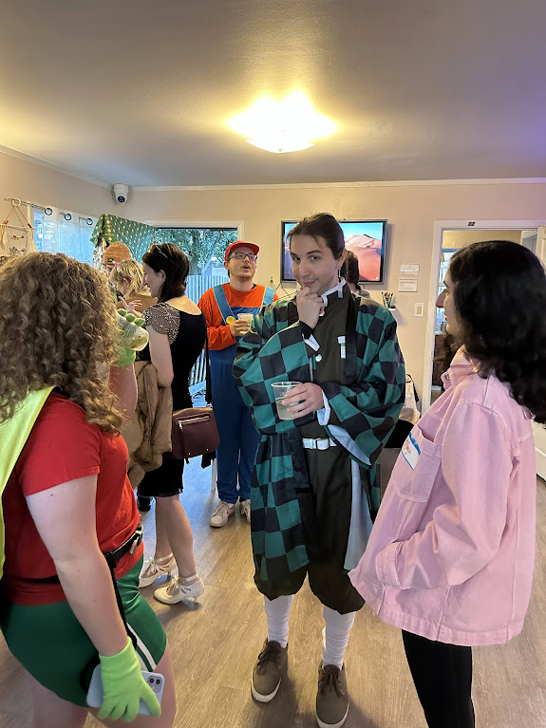
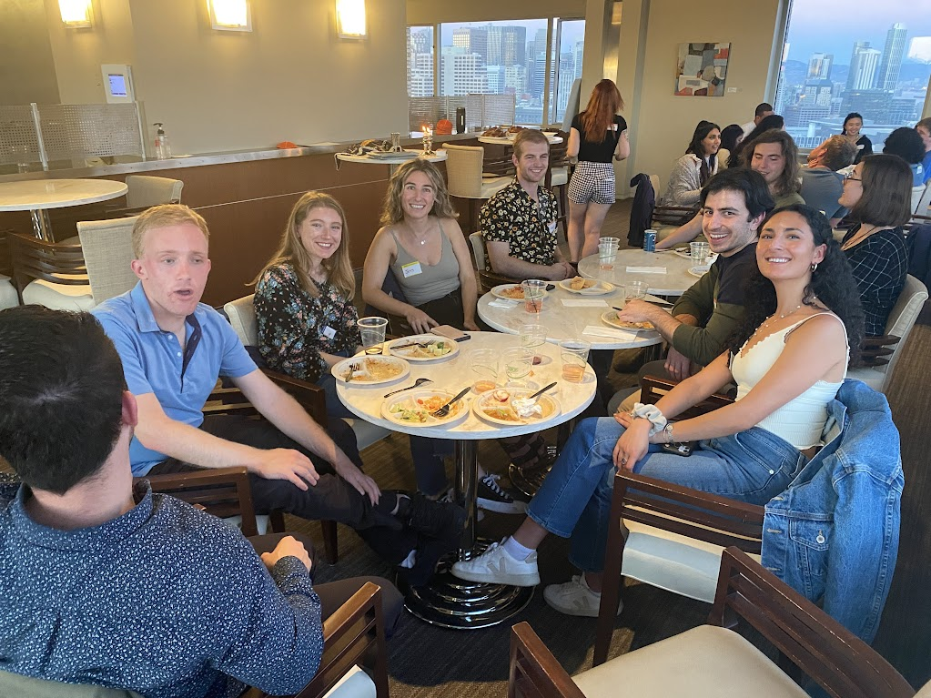
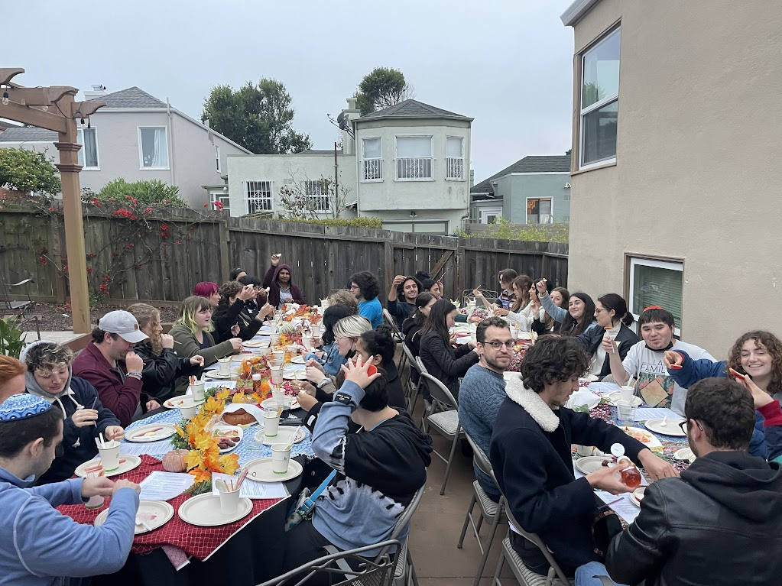
OTHER EVENTS
Israeli Cooking Night
Hamentaschen Making
Movie Menches
Purim Shabbat
Jewish Law Student Association Shabbat
Rosh Hashana

Slide 14
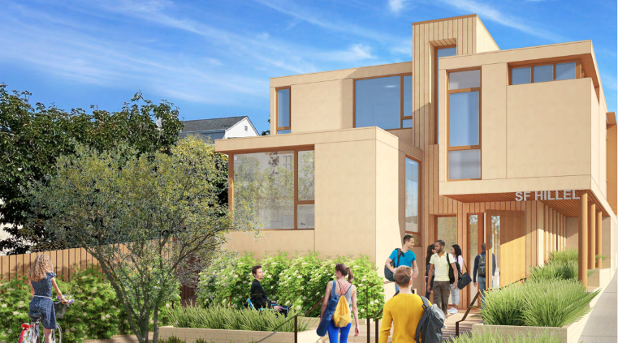




STRATEGIC PLANNING FOCUS
SF HILLEL RENOVATION
FINANCIAL
RESILIENCE
STRONG
GOVERNANCE
VIBRANT
STUDENT LIFE
To support larger student capacity and offer private space for confidential support. Our building needs to be accessible to all and a symbol of pride for Jewish Life for college students and the broader Jewish Community
Crucial to the long-term health of SF Hillel, we need to ensure SF Hillel is set up for financial resilience and growth for generations to come.
The board ensures sound financial management, strategic planning, and risk management.
Core to our mission, we need to ensure we not only support and engage as many students as possible, but they return often, assume leadership roles, and are empowered with the tools to become our future leaders.

Slide 15
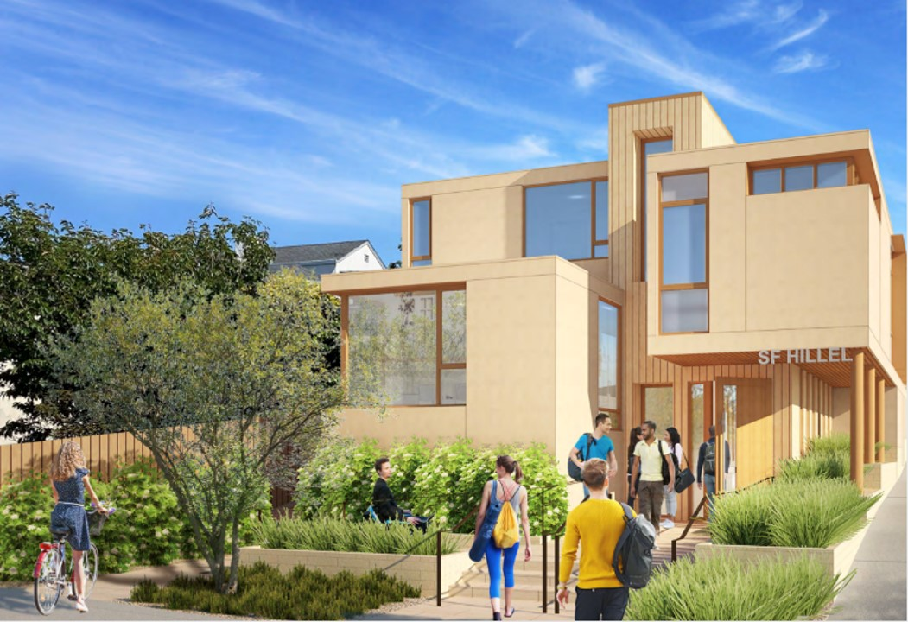
Building Renovation Needs
Target: $7.6M. Raised FY23: $2M
MORE CAPACITY
Our current building becomes overcrowded with just 20 attendees. We need to host upwards of 80-100 students at a time.
PRIVATE SPACE
Currently, we have no space to provide pastoral care or hold any confidential discussions with students.
INCLUSIVITY
Our building is not ADA compliant, making it difficult (if not impossible) for some with physical disabilities to participate.
SYMBOL OF PRIDE
As the center for Jewish life in San Francisco, our building should be a symbol of pride for college students, the larger community, and a strong presence in the face of antisemitism on campuses.

Slide 16
Thank you to our 2022-2023 Capital Campaign Supporters!
$250K+
Anonymous
Libitzky Family Foundation
$50K-$249K
Mimi Gauss
$10K - $49K
Laura and Gary Lauder Family Venture Philanthropy Fund
Rick & Ally Lenat
Phil & Cindy Strause
$1-$9999K
Marilyn Brenner
Thomas & Kendra Kasten
Linda & Frank Kurtz
Garrett Langfeld
Deborah Lopez & Jorge Flor-Lopez
Diane Marcus
Sam Moss
George & Jo Ann Schapiro
Ilana Shoyket
Shana Dines Wagner
Rhoda & Sheldon z"l Wolfe

Slide 17

The board of trustees and staff offer their sincere thank you for all your support. Everything we highlighted in this report could not happen without you.
Thank you!
SF Hillel Board of Trustees 2023-2024
N. Jeremy Kasdin, President
Ari Abramson, Vice President
Ilana Shoyket, Secretary
Jamie Cohen
Phil Strause
Carol Weitz, Capital Campaign Chair
Garrett Langfeld
Benjamin Gold-Matejka
Zach Weinstein
Staff
Roger Feigelson, Executive Director
Sophie Case, Director of Operations & Finance
Emily Simons, Associate Director of Community Engagement
Sarah Birch, Director of Student Life
Noah Goldstein, Springboard Fellow – Innovation Specialist
Matt Lacoff, Springboard Fellow – Jewish Education Specialist

Slide 18
Thank you to our 2022-2023 Supporters!
Visionary ($25K+)
Hillel International
Koret Foundation
Maccabee Task Force Foundation
San Franciso Jewish Community Federation and Endowment Fund
Priscilla Chan & Mark Zuckerberg
Leader ($10K - $24,999)
Jim Joseph Foundation
Lisa & Douglas Goldman Fund
Carol Weitz
Philanthropist ($5K - $9,999)
The Honorable Ina Gyemant
San Francisco Humanities Inc.
Rick & Ally Lenat
Kathy Fields & Garry Rayant
Phil & Cindy Strause
Sponsor ($1800 - $4,999)
Friend Family Philanthropic Fund
Mimi Gauss
N. Jeremy & Rakefet Kasdin
Barbara & Ron Kaufman
Larry & Deborah Stadtner
Shana Dines Wagner
Shauna & Brian Worthington
Partner ($1K - $999)
Mark & Gilah Abelson
Julius Aires
Jan Reicher & Yossi Alouf
Wendy Bear
Mitchell Bonner
Abi Karlin-Resnick & Andy Cheng
Jamie Cohen
Sara & Bruce Fischer
Sheila Reicher Fine Foundation

Slide 19
Thank you to our 2022-2023 Supporters! (Cont.)
Partner ($1K - $999, cont.)
Martin Harband & Gail Friedman
Philip Goldstein & Cathy Dobbs Goldstein
Robert & Wendy Grossman
Sher Right Fund
Bridget Katz & Yoav Schatzberg
Deborah Lopez & Jorge Flor-Lopez
Josh Smith
Valli Benesch & Robert Tandler
Diane Weinstein
Supporter ($500 - $999)
Jessica & Joel Birch
Larry & Helene Edelman
Lionel Engelman
Robert Feigelson
Selma & Paul Forkash
Peter & Barbara Gleichenhaus
Lauren Goldstein
Marsha & Ralph Guggenheim
Judith & Paul Heim
Garrett Langfeld
Siesel & Howard Maibach
James Heeger & Daryl Messinger
Betty Newman
Lee & Stephanie Notowich
Stuart & Joanne Oremland
Karen Perlman & Brian Perlman
Sheldon & Rose Rosenthal
David & Judi Rosner
George & Jo Ann Schapiro
Norman & Adrienne Schlossberg
Adina Wollner
Friend ($1 - $499)
Shushannah Akin
Bernard & Joanne Arfin
Susan & Gordon Bardet
Frank & Lilo Battat
Leah Beck
Riva & David Berelson
Eugene Berg

Slide 20
Thank you to our 2022-2023 Supporters! (Cont.)
Friend ($1 - $499), cont.
Rachel Berger
Debbie Berkowitz
Mike Berkowitz
Jonathan Bernstein
William Bernstein
Judy & Jordan Bloom
Natalie Boyanovsky
Philip & Alison Braverman
Susan Cable
Ruth & Ari Caprow
Edward Case
Sophie Case
Leah Chakoff
Victoria Chen
Ashwin Chidambaram
Eve Cohen
Anna & Leon Cooper
Michael Cronbach
Jeremy Crowe
Barb Cymrot
Susan & Michael Dab
Dr. Daniel & Leslie Davidson
John & Jobyna Dellar
Jeffrey Schneider & Jane Denton
Edward Luby & Pamela Derish
Howard Chabner & Michele Desha
David & Sandra Eliaser
Mark Rudow & Barbara Elliott
Derek Evan
Leland & Susan Faust
Alyssa Feigelson
Richard Felton
Daniel & Nina Fendel
Gregg Feigelson
Roger Feigelson
Marsha Cohen & Robert Feyer
Bunnie Finkelstein
Lisa Finkelstein
Sera Fleishman
Sarah & David Friedkin
Dr. Steven Foreman
The Somekh Family Foundation
Debbie Frank & Gary Frank
George Frankenstein
Abe Froman
Dobbs Philanthropic Fund
The Silverman Family Fund
Jonathan Funk
Mark Furman
Raisa Furman
Joshua Gamson
Danny Grossman & Linda Gerard
Eric Husby-Gerry, D.C.
Barry & Elaine Gilbert
David & Marcia Glassel
Allen Goldstein
David Goldstein
Dr. Burton & Eleanore Greenberg
Marci Fox Greene
David Greenseid & Dolores Gould
Solomon Gorlick
Alan & Susan Greinetz
Alyssa Gutierrez
Judi Elman - Harris
Dr. Ronald & Marsha Harris
Hebrew Free Loan Association
Ephraim Hirsch
Deborah Hoffman
Dona & Jordan Hopstone
Larry & Anne Hopp
Marilyn Jacobs
Jill Jacobson
Neil Jacobson
Hannah Jensen
Lori Jennex
Daniel Kahn
Robert & Marjorie Kaplan
Harriet & Moti Kattan
Allan & Marilyn Katz
Jason Katz
Susan Katz
Dr. Brian Kaye & Mrs. Fran Tannenbaum Kaye
Michael & Rachel Kesselman
Rabbi Jessica & Ross Kirschner
Mark & Julia Klebanov
Quentin & Mara Kopp
Jerrold & Ellen Korn
Jemma Kosalko
Jack Kower
Susan & Mark Lachtman
Carol Langbort
Lynn Langfeld
Charles & Feralee Levin
Deborah Pollak Levy
Julie & Ari Lewis
Ronald Lezell
Laura Beth Linford
Bruce Maclaren

Slide 21
Thank you to our 2022-2023 Supporters! (Cont.)
Friend ($1 - $499), cont.
Karen Malone
Diane Marcus
Mike Marron
Kyle Martin
Allen & Cecilia Mayer
Scott McDonald
Maya Menachem
Dr. & Mrs. David & Elfriede Menke
Marilyn Zimmerman & Rob Mickel
Dr. Stephen & Marlene Miller
Ollie Benn & Kate Mirkin
Mira Chetlen & Sam Moss
Carla Naylor
Gail & Bernard Nebenzahl
Robert & Diane Neuhaus
Lisa Nissim
Alex Offer
Peter Pollat, M.D.
Harriet Prensky & Bill Pomeranz
Luis Portillo
Sasha Presley
Rachel & Ricky Nilson Ralston
Dr. Gerald Roberts, M.D.
Saul & Barbara Rockman
Cassie Rodocker
Cindy Rogoway
Liana Rokh
Eve & Alan Rosenfeld
Debbie & Rob Rosemont
Sarah Rosemont
Lynne Rosenthal
Wendy Rothenberg
Zack Sanderson
Elizabeth & David Samuelson
Steven Sarver
Kristin Saunders
Henry & Rebecca Scheinberg
Mark Schulman
Carolyn Pines & Judith Schwartz
Maralyn Tabatsky & Ken Schwer
Rita & Elisabeth Semel
Tina Shih
Alexander Shoyket
Ilana Shoyket
Michael Shriver
Eva & Earl Shulman
Andrea Simon
Bonnie Simons
Emily Simons
Robert Singer
Feiga Sklovsky
Howard & Susan z"l Slayen
Dr. Lawrence & Jaqueline Slayen
Steven & Rhona Sloan
Gabe Smallson
Monique & Steve Smallson
Zayla Smith
Susan & Richard Sorkin
Sara Haber & Beth Souza
Tamar Stein
Leslie & Alan Steinberg
Eric Stone
Herb Tobin
Carol & Norman Traeger
Holly Trief
Norma Zimmerman Trust
Anthony Tsatskin
Sydney Kapchan & Steven Tulkin z"l
Dr. Maxwell & Dorothy Tuman
Hollace & Ed Ungerleider
Kayla Vergara
Paul & Dorothy Wachter
Corinne Walder
Julian Weinstein
James Whitehead
Jack Whistler
Rhoda & Sheldon z"l Wolfe
Ron Blatman & Emerald Yeh
Charles Yoakum
Naomi Zipursky
An additional thank you to all our supporters who chose to remain anonymous.

